Slide 1

Traditional vs Modern literacy
JERONIM RAGUŽ, MAJA KLAFURIĆ, LARA CVETKO I NIKA ŠIRANOVIĆ 3.B

Slide 2
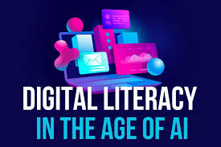
How has the meaning of literacy changed in the 21st century?
From printed texts to digital content
Reading online articles and social media
Writing emails and messages
Using technology to communicate

Slide 3

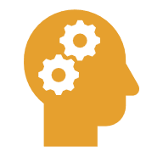


What’s the difference between traditional and modern literacy
Reading books and newspapers
Grammar and vocabulary skills
Using computers and smartphones
Communicating digitally

Slide 4
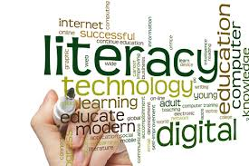
Is reading books still important in the digital age?Why or why not?
Yes
Improves vocabulary
Develops concentration
Encourages critical thinking
Helps personal development

Slide 5
How does technology and the internet influence the way pepole read and write today?
Faster access to information
Shorter texts
Less focus on long reading

Slide 6
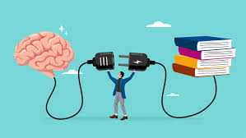
Do you think modern literacy skills are more important than traditional ones?
Modern literacy is more practical today
Traditional literacy builds strong basics
Both are important
Best results when combined

Slide 7
Conclusion
Literacy has changed in the 21st century
Digital skills are necessary today
Traditional literacy is still important
Balance between both is the key

Slide 8
DIGITAL LITERACY
Tea Zirdum i Magdalena Višić, 3b

Slide 9

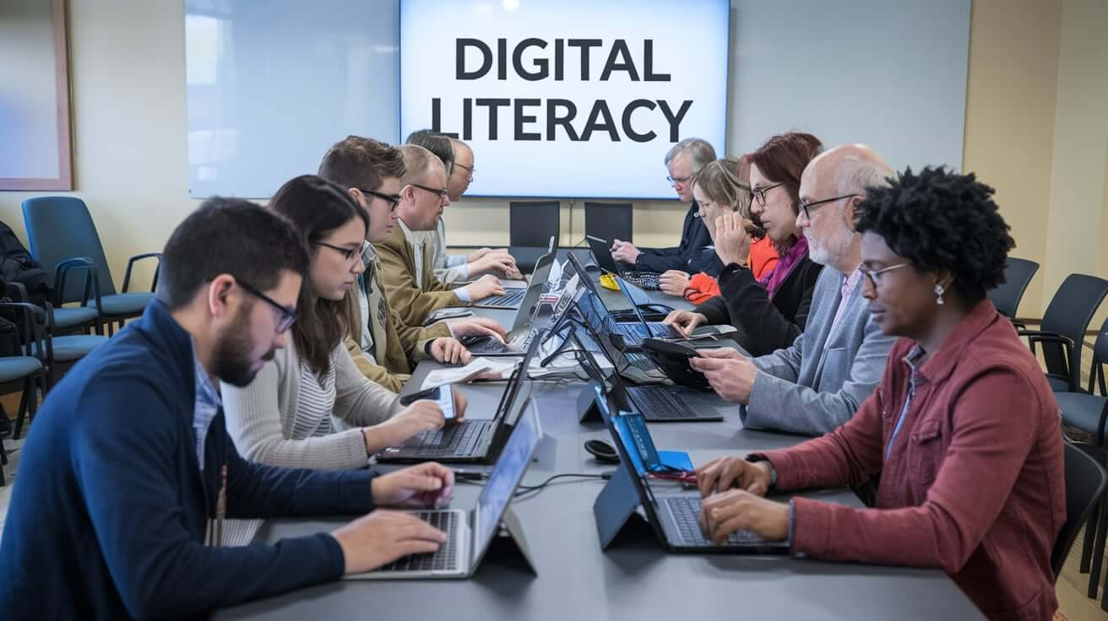
What does digital literacy mean in today's world?
To ability to use digital technologies
Finding, understanding and evaluating online information
Using the internet safely and responsibly
Communicating through digital tools

Slide 10
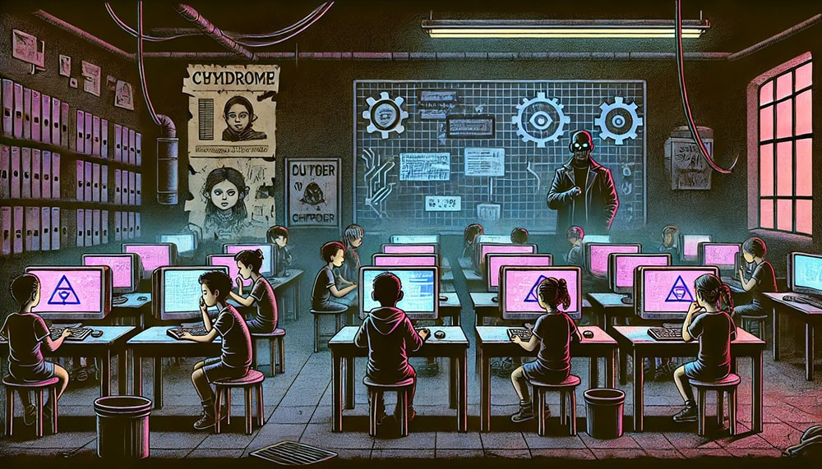
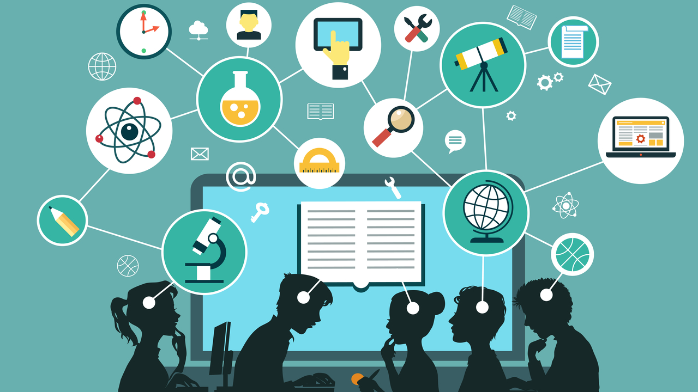
Why is digital literacy important for students and workers?
Makes learning and research easier
Requried for most jobs today
Improves communication and teamwork
Helps people adapt to modern society

Slide 11

What digital skills sholud every young person have in the 21st century?
Using computers and smartphones
Working with documents and presentations
Searching for information online
Basic online safety skills
Responsible use of social media

Slide 12
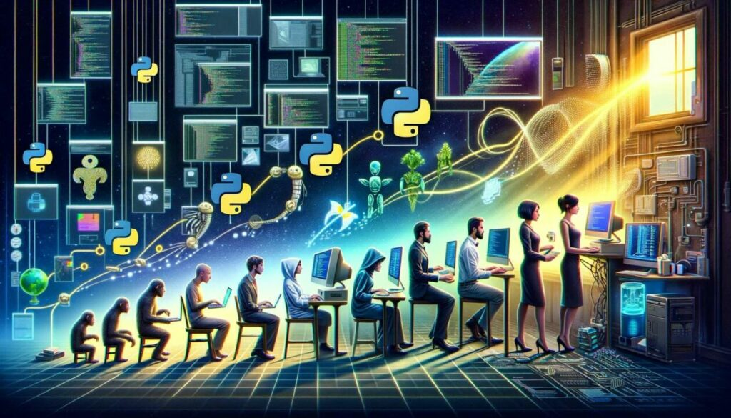
What are the risks of poor digital literacy?
Spreading fake information
Online scams and date theft
Cyberbullying
Difficulties at school and work

Slide 13
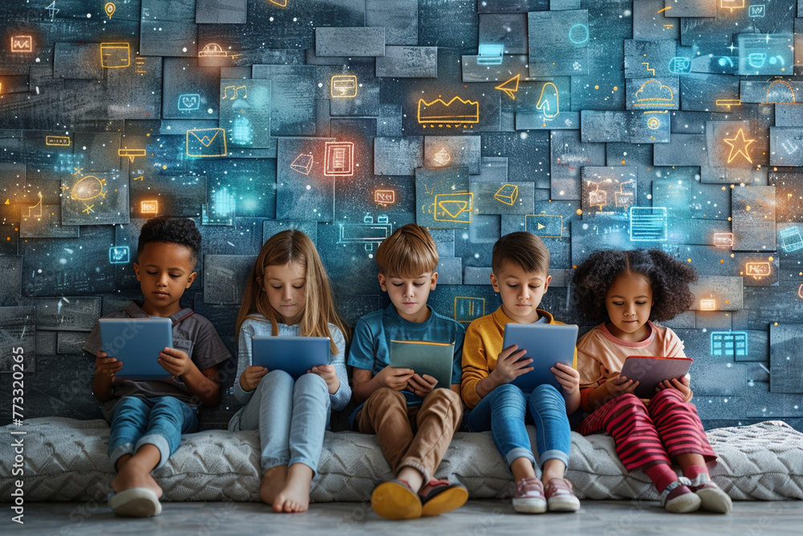
How can schools help students become digitally literate?
Using digital tools on lessons
Teaching online safety
Encouraging critical thinking
Practical tasks and projects
Teacher training

Slide 14

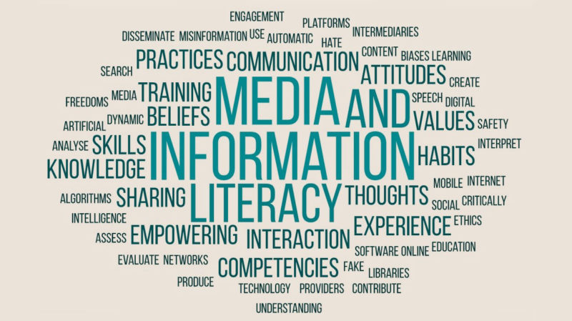
Media and Information Literacy
Lukas Ladišić, Karlo Kvesić, Toma Povrženić, Filip Stopić 3.b

Slide 15

What is media and information literacy?
The ability to access, analyze, evaluate, and create media and information.
Helps people understand how media messages affect thinking and behavior.
Encourages responsible use and sharing of digital content.
Combines skills in reading, technology, and critical thinking.

Slide 16
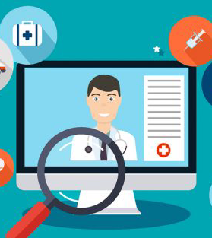
Why is it important to check the reliability of online information?
The internet contains both accurate and false information.
Checking sources prevents the spread of misinformation.
Reliable information supports good decision-making.
Builds trust and credibility when sharing content.
Protects users from scams, fake news, and manipulation.

Slide 17

How can people recognize fake news?
Check the source — is it a trustworthy or official website?
Look at the author — are they credible and verifiable?
Watch for emotional or sensational headlines.
Cross-check the story with other reliable news outlets.
Check dates, images, and writing style for inconsistencies.

Slide 18
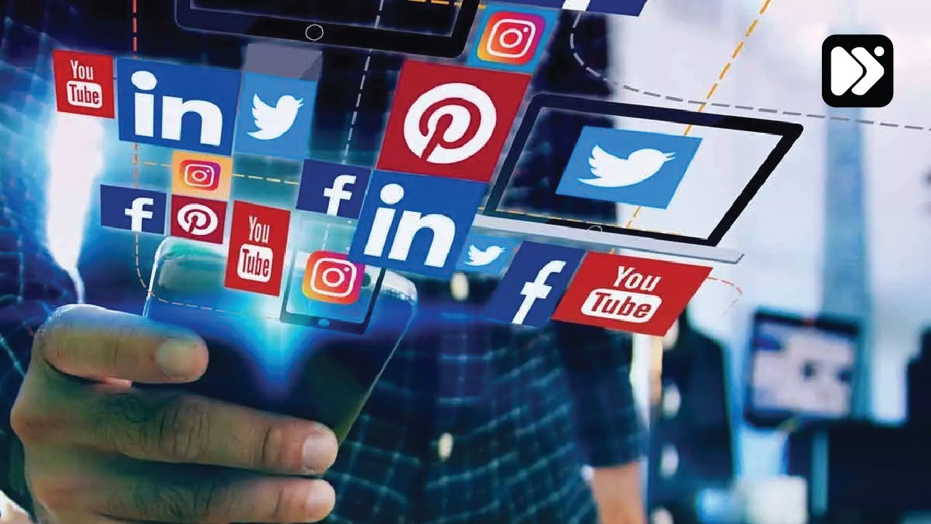
What role do social media platforms play in spreading information?
Social media allows information to spread quickly to millions.
Platforms can amplify both truthful and false information.
Algorithms show content based on engagement, not accuracy.
Influencers and users play a huge role in shaping opinions.
Platforms are beginning to use fact-checking tools to reduce misinformation.

Slide 19
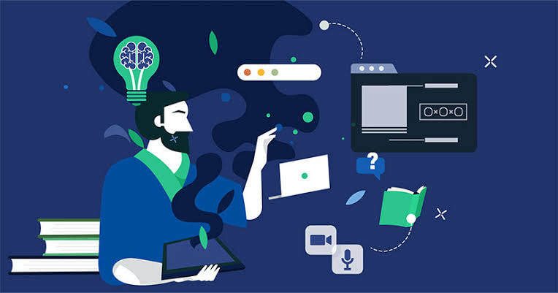
How can young people become more critical media users?
Learn to question and fact-check all information before sharing.
Understand how media and advertising influence opinions.
Use multiple sources to form balanced views.
Develop digital literacy skills in school and everyday life.
Stay curious, open-minded, but also skeptical of what’s online.

Slide 20

Summary / Reflection
Media literacy empowers responsible and informed citizens.
Always verify information before believing or sharing it.
Awareness and education are the keys to fighting misinformation.
Be a smart, ethical, and critical media consumer.

Slide 21
Media and Information Literacy
Ana Maria Guzman, Ema Vrbanić, Lara Barbara Bečić i Lea Simić
3.b

Slide 22
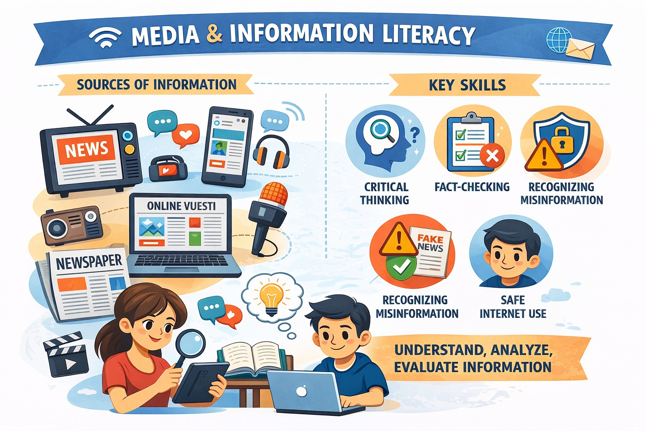

Slide 23

What is Media and Information Literacy?
Media and Information Literacy (MIL) is the ability to access, analyze, evaluate, and create media and information in various forms.
It helps people understand how media messages are created and how they influence opinions and behavior.

Slide 24

Why is it Important to Check Online Information?
Not all information online is true or reliable.
Checking reliability helps avoid misinformation, scams, and manipulation.
It allows people to make informed decisions based on facts.

Slide 25
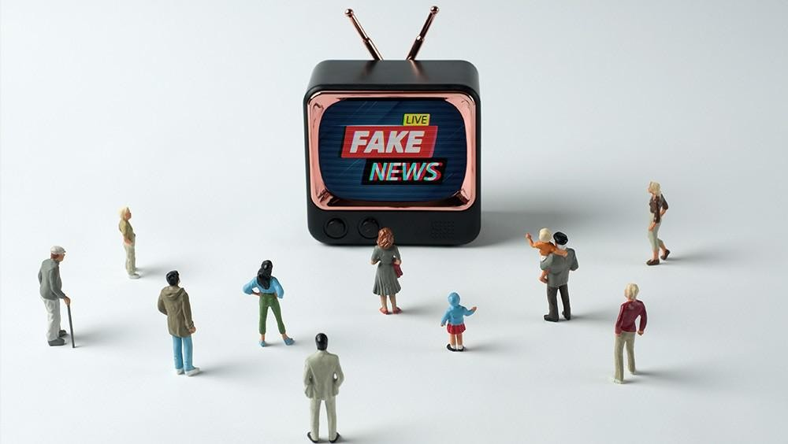
How Can People Recognize Fake News?
Check the source and author of the information.
Look for evidence and reliable references.
Compare the news with other trustworthy sources.
Be careful with sensational headlines.

Slide 26
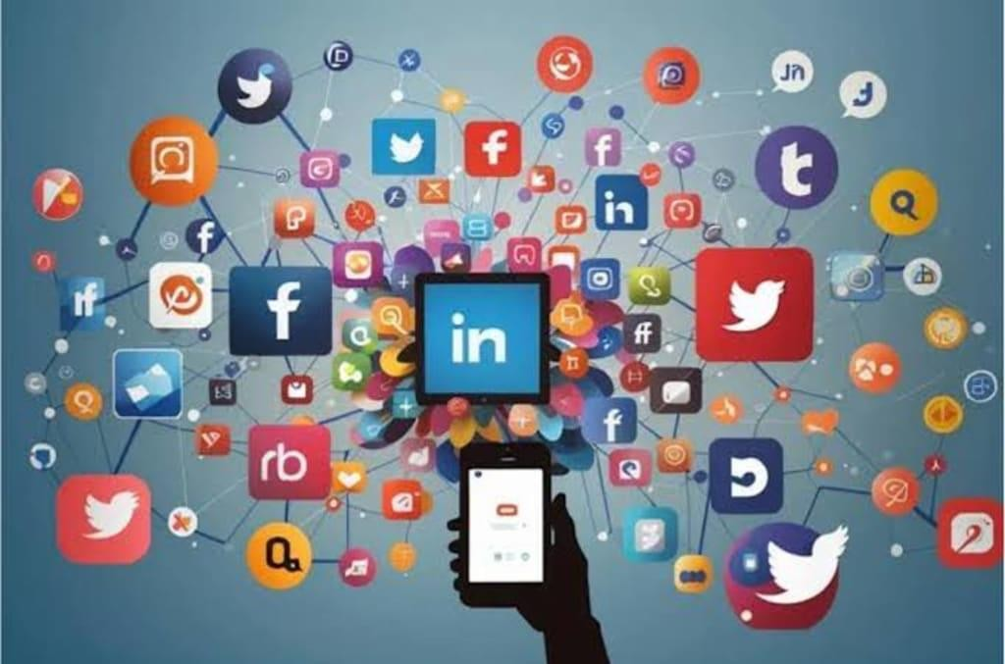
Role of Social Media in Spreading Information
Social media spreads information quickly to large audiences.
It can share both accurate information and misinformation.
Algorithms often promote popular or emotional content.

Slide 27
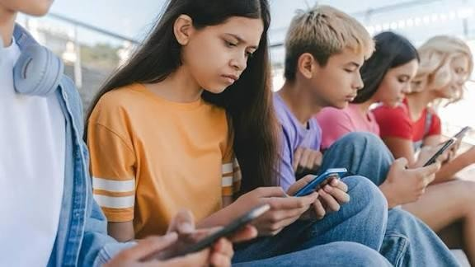
How Can Young People Become Critical Media Users?
Learn to question and analyze media content.
Verify information before sharing it.
Develop digital and media literacy skills.
Use reliable and educational sources.

Slide 28
Literacy and Social Inclusion
Marko Divić,Fran Škorić,Patrik Pintarić,Dario Tišljarec

Slide 29

How does literacy influence a person's opportunities in life?
Improves access to education and lifelong learning
Increases chances of employment and higher income
Helps people make informed decisions about health and finances
Builds confidence and independence in everyday life

Slide 30
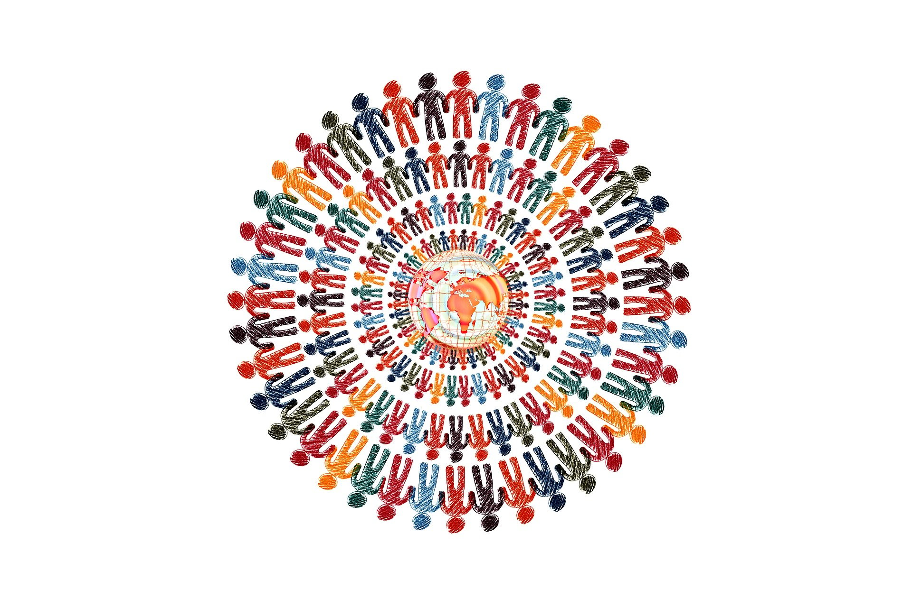
Why is literacy important for social inclusion?
Enables participation in social, cultural, and civic life
Helps people communicate effectively and express their views
Reduces social isolation and exclusion
Supports equal access to services and rights

Slide 31
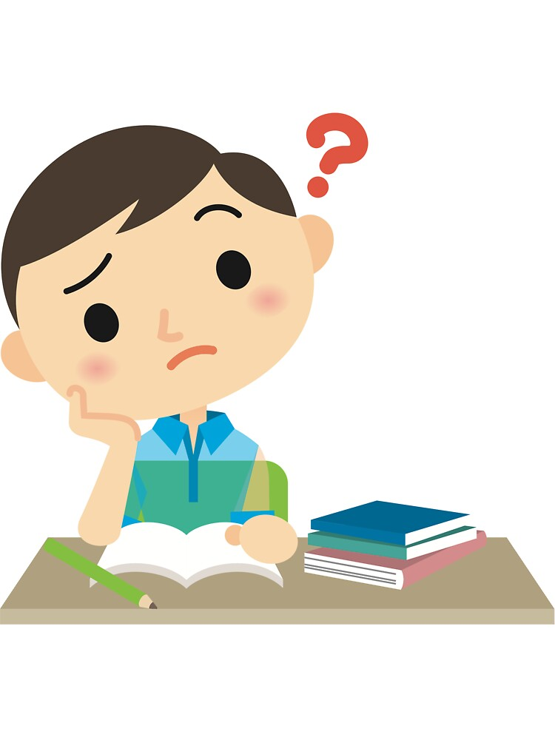
How can low literacy levels affect individuals and communities?
Limited job opportunities and higher unemployment
Greater risk of poverty and social exclusion
Difficulty accessing healthcare and public services
Slower economic and social development in communities

Slide 32

Which groups are most at risk of low literacy levels?
Children from disadvantaged backgrounds
People with limited access to education
Migrants and refugees facing language barriers
Older adults who left education early

Slide 33

How can governments and organisations improve literacy levels?
Invest in quality early childhood and school education
Provide adult literacy and lifelong learning programs
Support libraries, community centers, and digital access
Promote inclusive education policies and awareness

Slide 34
THE FUTURE OF LITERACY

Slide 35

HOW DO YOU THINK LITERACY WILL CHANGE IN THE FUTURE?
In the future, literacy will be more than just reading and writing. It will include digital, media, and information literacy, such as using technology effectively and evaluating the reliability of information.
People will read more from screens, use multimedia, and communicate online more often, while critical thinking, adapting to new technologies, and working with artifical intelligence will be essential skills.

Slide 36
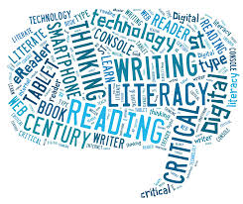
WILL ARTIFICAL INTELLIGENCE AFFECT READING AND WRITING SKILLS? HOW?
Artifical intelligence is becoming commom in schools and daily life. It helps students find information quickly and understand texts through tools like summaries and translations. However, relying on short online texts can reduce concentration, so AI should be used critically.

Slide 37
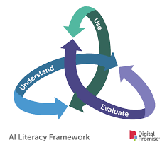
AI helps students write essays by correcting grammar and spelling, making writing faster and easier. Still, students should not depend on it too much – AI should support learning, not replace their own work.
Artifical intelligence can improve literacy if used responsibility, with a balance between technology and independent thinking.
Notes:
37

Slide 38
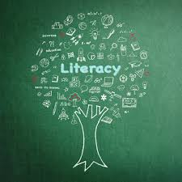
WHAT NEW LITERACY SKILLS MIGHT BE NEEDED IN THE NEXT 20 YEARS?
In the next 20 years, new literacy skills will likely include digital and media literacy, critical thinking, and the ability to evaluate information. Undestanding artifical intelligence and automation will become increasingly important.
People will need to use technology safely and responsibly, recognize misinformation, and adapt to constant changes in communication and work. Intercultural literacy will also be essential due to growing global connectivity.

Slide 39
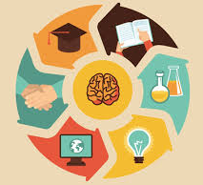
HOW CAN INDIVIDUALS PREPARE THEMSELVES FOR FUTURE LITERACY CHALLENGES?
Individuals can prepare for future literacy challenges by continuously improving their digital skills and staying open to lifelong learning. Developing critical thinking helps people evaluate information and avoid misinformation.

Slide 40
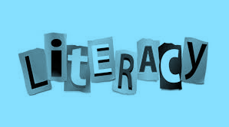
Learning how to use new technologies, including artifical intelligence, in a responsible way is also important. Reading regulary in different formats, such as digital texts and multimedia content, can strengthen understanding and adaptability.
Additionally, practicing clear and respectful online communication will help individuals succees in an increasingly digital and connected world.

Slide 41

DO YOU THINK PEOPLE WILL READ LESS OR MORE IN THE FUTURE? EXPLAIN.
People will probably learn more in the future, but in a different way. Technology provides easy access to information, so learning will be faster and more flexible. Online courses, videos, and artifical intelligence make it possible to learn anytime and anywhere.
However, people might depend too much on technology and remember less. Because of this, critical thinking and understanding will become more important than memoriying facts.

