Slide 1

United Nations Day
4.a

Slide 2
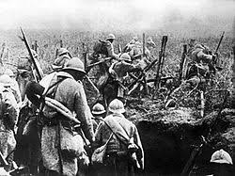
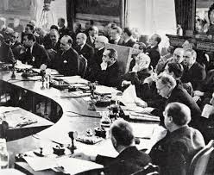
What historical events led to the creation of the United Nations?
World War I (1914–1918)
League of Nations – failed to keep peace
World War II (1939–1945)
Massive destruction and loss of lives
Need for a new international organization

Slide 3
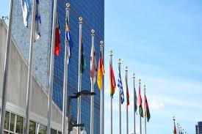
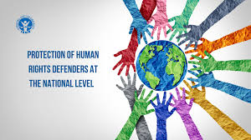

What were the main aims of the UN when it was founded?
Maintain international peace and security
Prevent future wars
Protect human rights
Promote cooperation between countries
Improve living conditions worldwide

Slide 4




Who were the founding members and why was international cooperation necessary?
Founding members: United States, United Kingdom, Soviet Union (USSR), China, France
World War II caused huge destruction, so countries realized they needed to work together to prevent future wars and keep global stability.

Slide 5
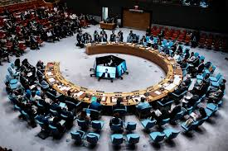
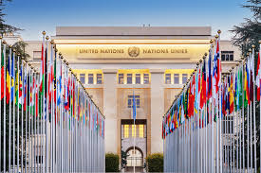
Do you think the Unis still relevant today?
The UN is still relevant because
It helps countries talk instead of fight, which can prevent wars
It provides humanitarian aid (food, medicine, shelter) during wars, disasters, and famines.
It works on global problems like climate change, disease, refugees, and human right
UN peacekeepers help keep peace in some conflict areas.

Slide 6
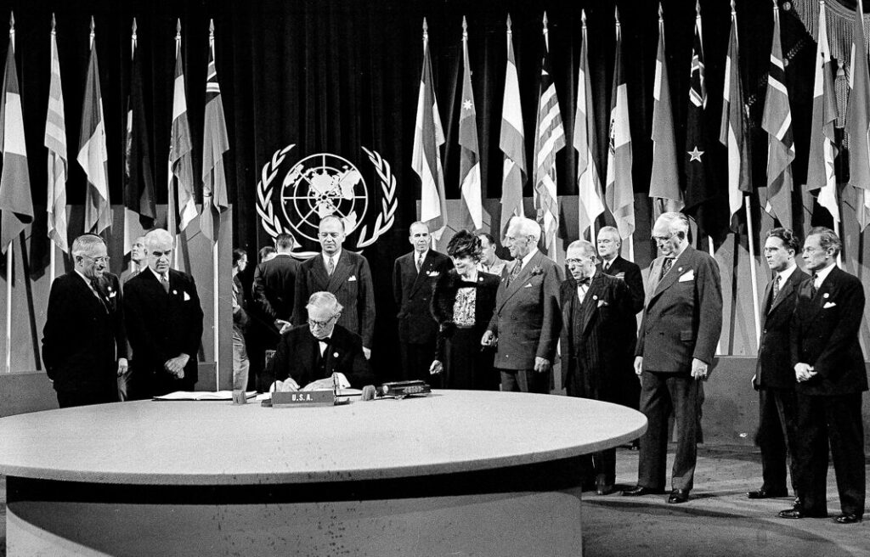
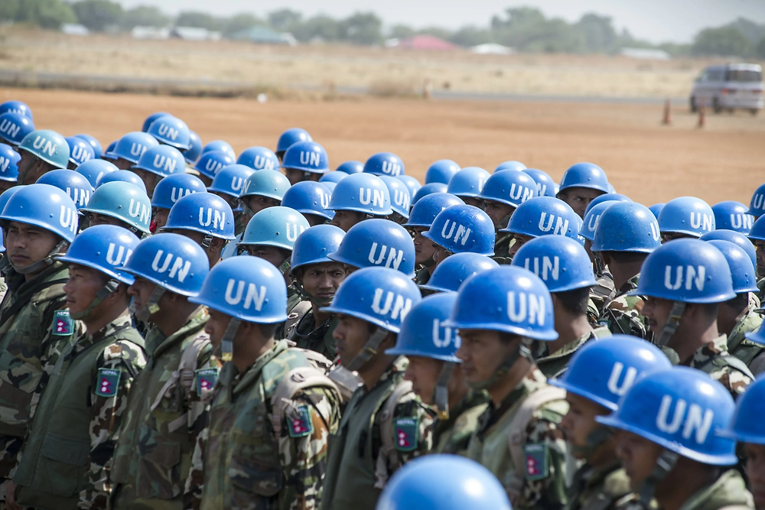
How has the role of the United Nations developed since 1945?
Original role (1945):
• Prevent another world war after WWII.
• Provide a forum for diplomacy and collective security through the Security Council.
How it developed:
• Peacekeeping emerged in the late 1940s (not explicitly in the UN Charter).
• Expanded from monitoring ceasefires to complex missions involving nation-building, civilian protection, and post-conflict reconstruction.
• Greater focus on conflict prevention, mediation, and counter-terrorism.
Limitations:
• Cold War vetoes often blocked action.
• Today, geopolitical rivalry still constrains effectivenes

Slide 7
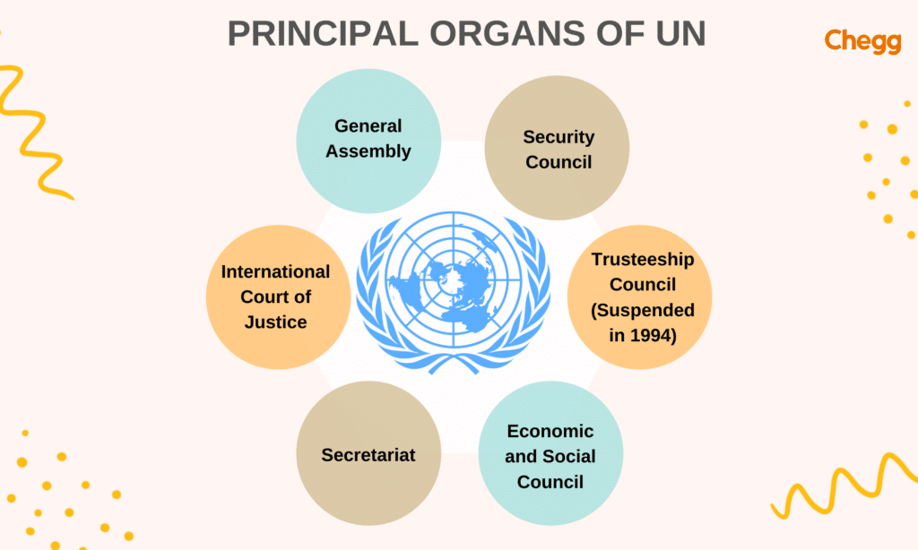
What are the six main organs of the United Nations?
General Assembly
Security Council
Economic and Social Council (ECOSOC)
Secretariat
International Court of Justice
Trusteeship Council

Slide 8
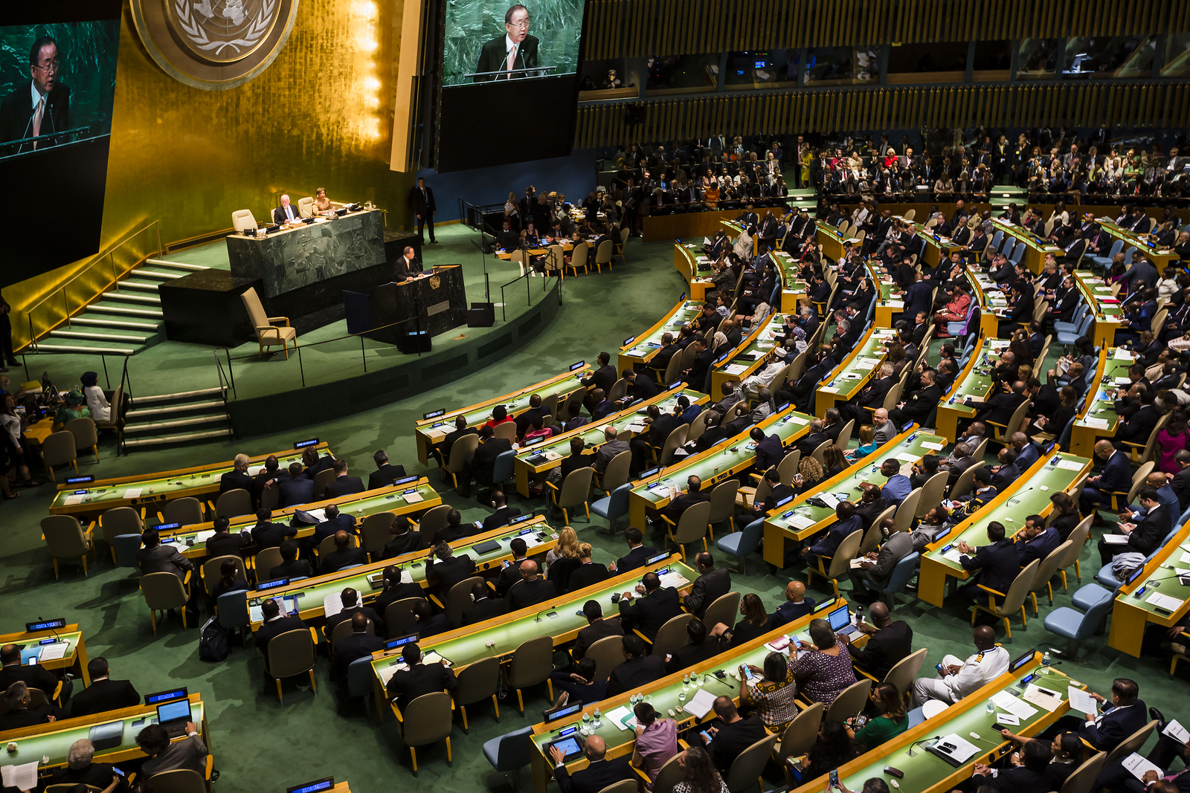
What responsibilities does the General Assembly have?
The General Assembly
Discusses global issues
Passes resolutions and recommendations
Aproves the UN budget
Admits new member states

Slide 9
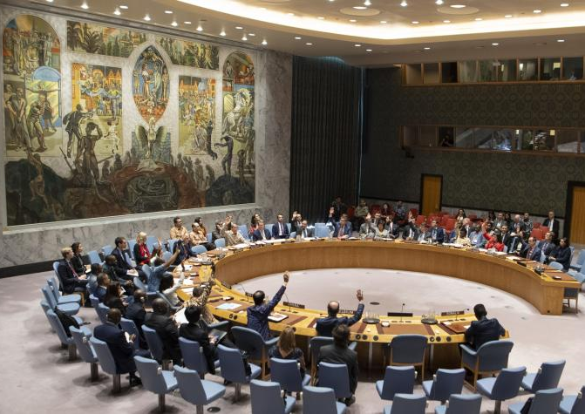
How does the Security Council make decisions?
The Security Council has 15 members:
5 permanent members
10 non-permanent members
Decision need at least 9 votes and no veto from permanent members

Slide 10

What is the role of the International Court of Justice?
The International Court of Justice
Settles legal disputes between states peacefully
Interprets international law and treaties
Gives advisory opinions to UN organs and agencies
Helps prevent conflicts between countries
Promotes justice and respect for international law
Contributes to global peace and security

Slide 11
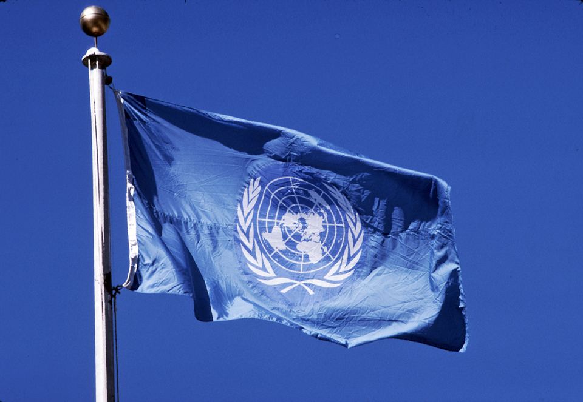
Why is cooperation between UN organs important?
The UN plays a crucial role in maintaining international peace and security.
Through cooperation between its main organs, the UN helps resolve conflicts, protect human rights, promote justice and support global development.
By working together, these organs contribute to a safer and more peaceful world for everyone

Slide 12
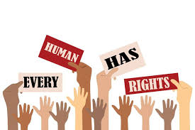
What are human rights and why are they essential?
Human rights are basic rights and freedoms that belong to every person, regardless of nationality, race, gender, religion, or beliefs
They are essential because they protect himan dignity, freedom, and equality, and help create fair and peaceful societies

Slide 13
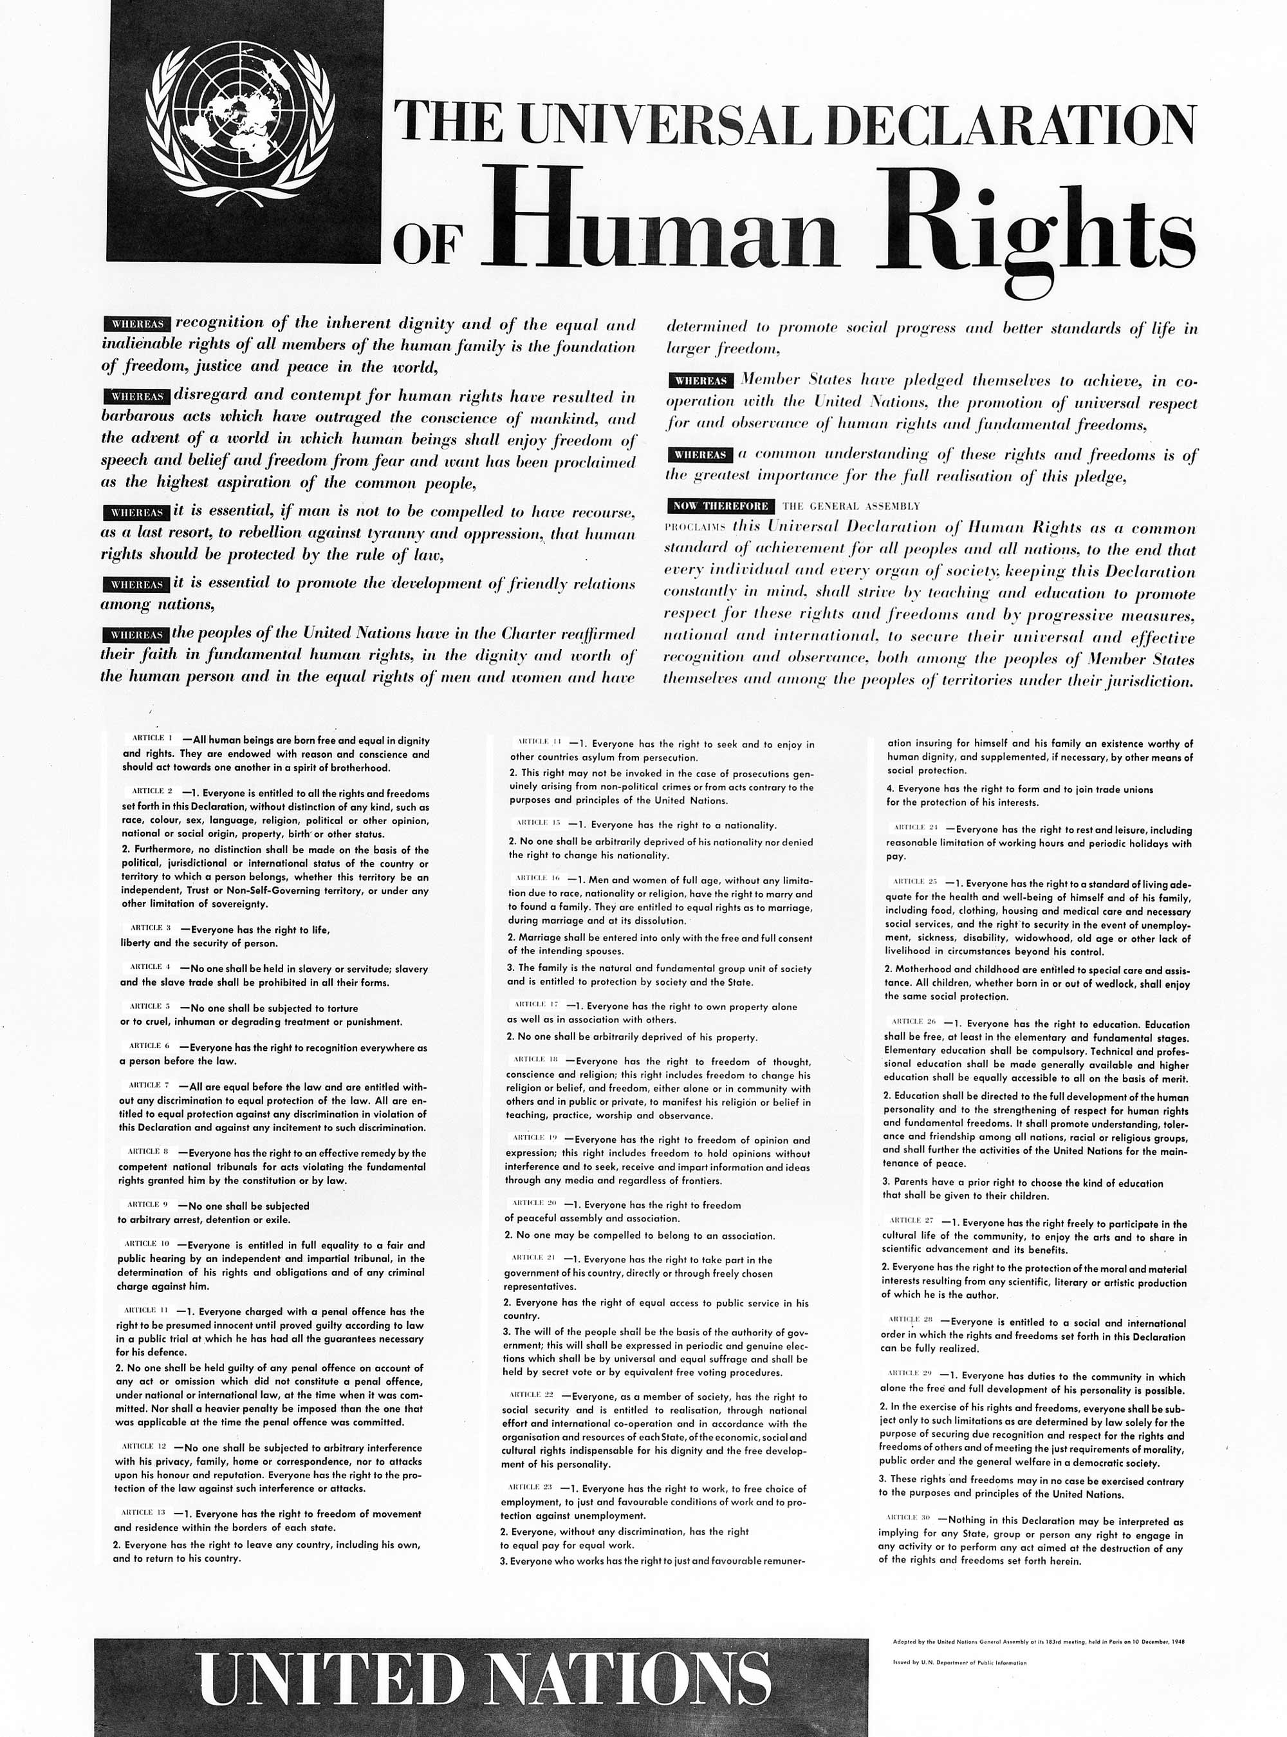
What is the Universal Declaration of Human Rights and why was it created?
The Universal Declaration of Human Rights is a document adopted by the United Nations in 1948.
It was created after World War II to prevent future human rights auses and to set common standards of rights for all people

Slide 14
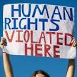
How does the UN respond to human rights violations?
Monitoring and reporting abuses
Sending special investigators and missions
Adopting resolutions and recommedations
Supporting vistims and encourading countries to respect human rights

Slide 15
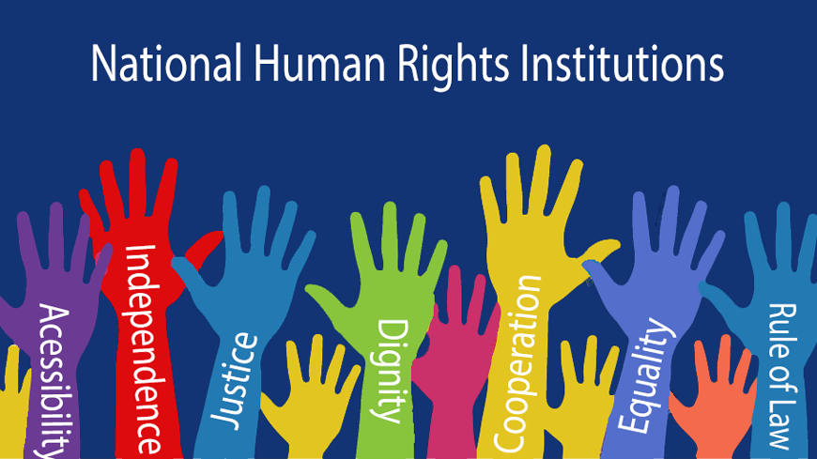
Examples of human rights challenges today
Wars and armed conflicts
Discrimination and racism
Violations of womens rights
Poverty and lack of access to education
Restrictions on freedom od speech

Slide 16
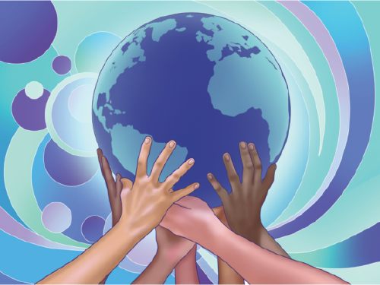
How can countries improve human rights protection?
Creating and enforcing dair laws
Educating citizens about human rights
Ensuring independent courts
Cooperating with UN and other international organisations

Slide 17
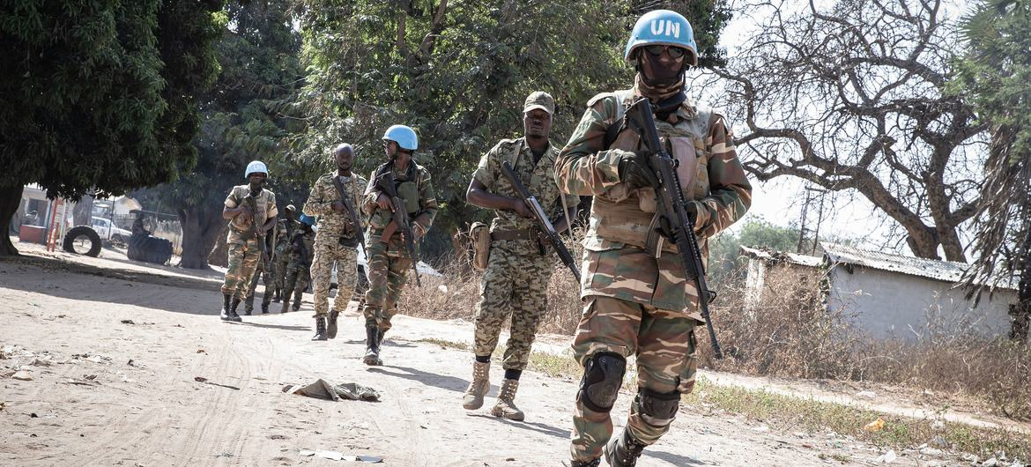
What is the purpose of UN peacekeeping missions?
The purpose of UN peacekeeping
missions is to maintain peace and
security in areas affected by
conflict. They help stop violence,
support ceasefires, protect
civilians, and create conditions for
lasting peace.

Slide 18
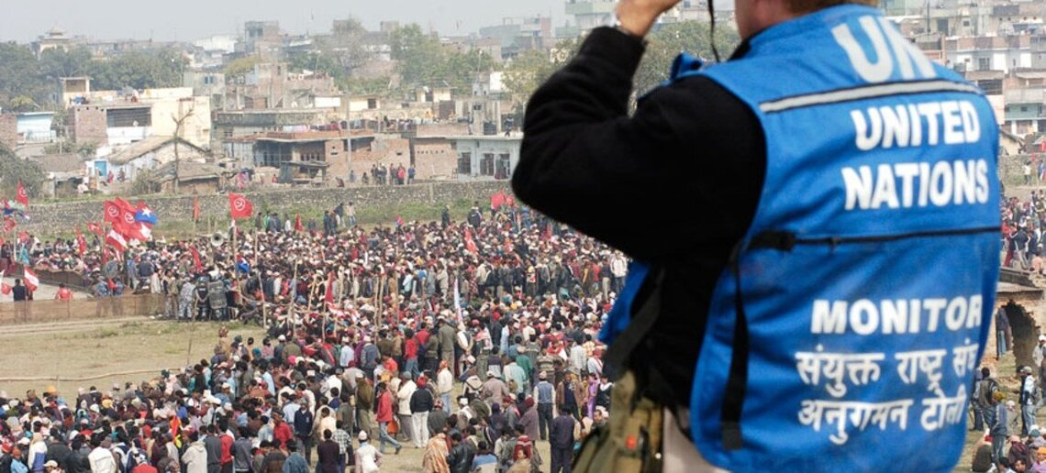
How do peacekeeper help maintain stability in conflict areas?
Peacekeepers help maintainstability by monitoring ceasefires, separating opposing forces, supporting elections, and assisting humanitarian aid. They also help rebuild institutions and promote dialogue between conflicting sides.

Slide 19
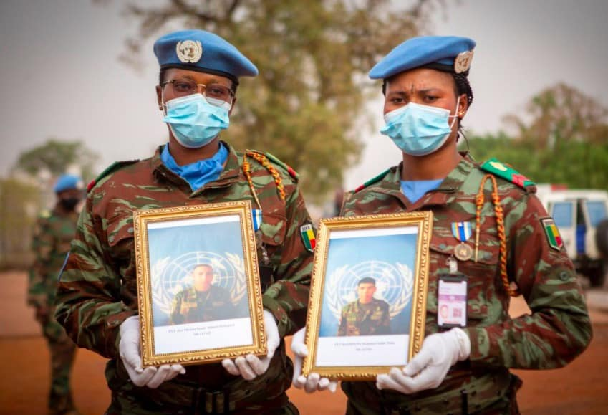
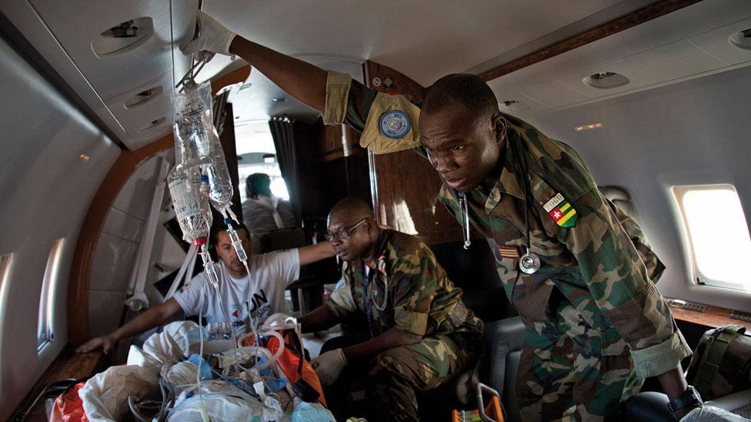
What risks do UN peacekeepers face?
UN peacekeepers face many
risks, including armed attacks,
landmines, terrorist threats, and
difficult living conditions. They
often work in unstable areas
where violence can happen at any
time.

Slide 20
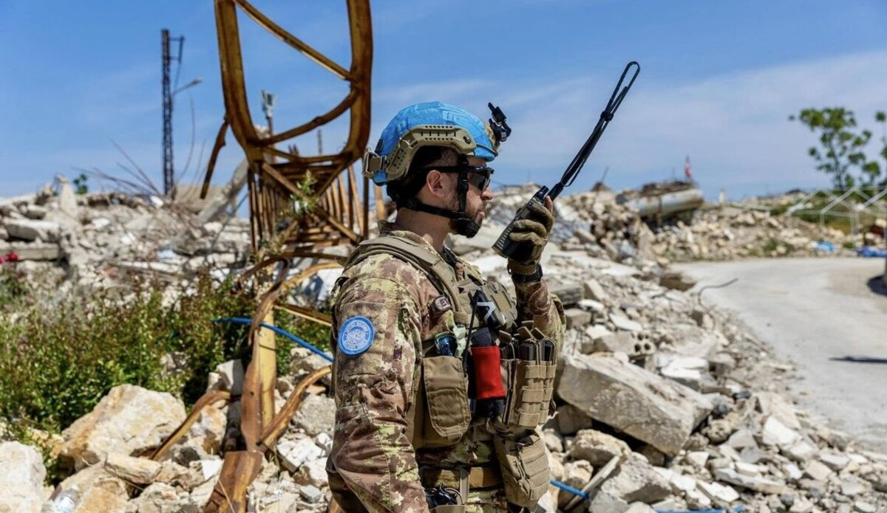
Can peacekeeping missions solve conflicts permanetly?
Peacekeeping missions cannot usually solve conflicts permanently on their own. They help reduce violence and create peace, but long_x0002_term solutions depend on political agreements, cooperation between parties, and strong local governments.

Slide 21
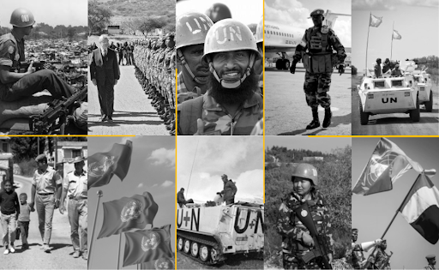
Give an example of a peacekeeping mission and its results
An example of a peacekeeping
mission is UNPROFOR in the
former Yugoslavia. Its role was to
protect civilians and deliver
humanitarian aid. Although it
faced many challenges, it helped
reduce violence and supported
peace efforts in the region.

Slide 22
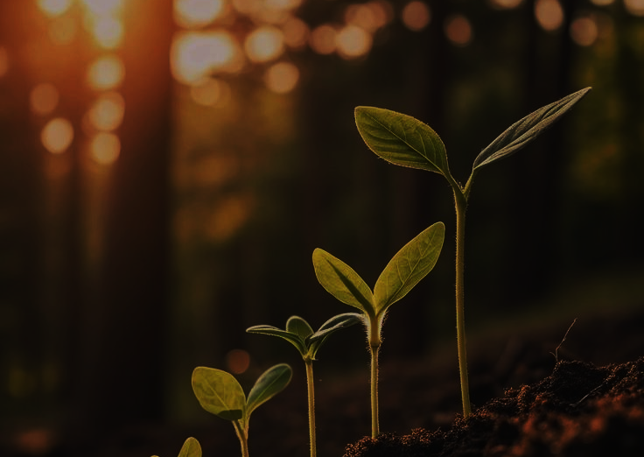
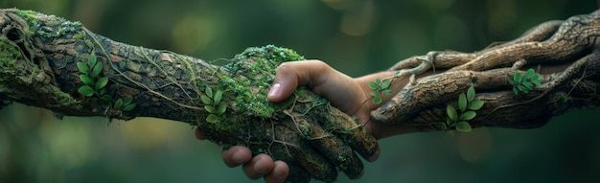
What are the Sustainable Development Goals and why were they introduced?
The Sustainable Development Goals (SDGs) are 17 global goals adopted by all UN Member States in 2015 as part of the 2030 Agenda.
They provide a universal framework to end poverty, protect the planet and improve well-being for all by 2030.

Slide 23

Which SDGs do you consider the most urgent today?
The UN presents all SDGs as equally critical and interconnected. Current global priorities often highlight urgent action on areas such as poverty, hunger, health, water, inequality and climate change, reflecting key global challenges.

Slide 24
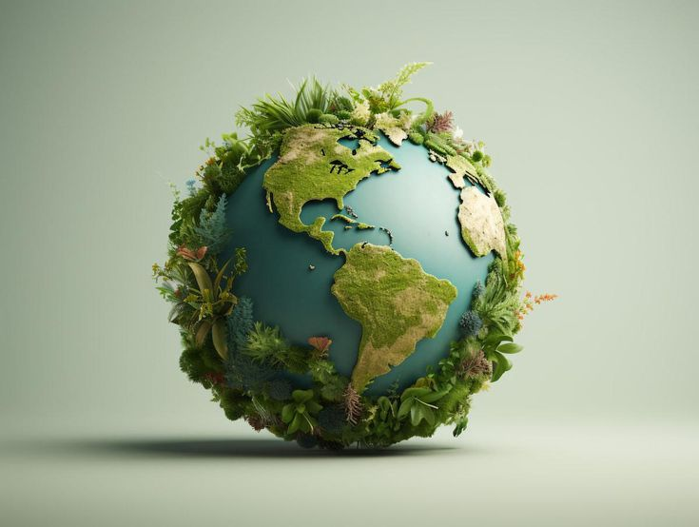
How do the SDGs influence global and local communities?
The SDGs serve as a shared blueprint for countries, cities, organizations and communities to plan and act on global challenges, improving quality of life, environmental protection and inclusive development on all levels.

Slide 25

What role do governments play in achieving the SDGs?
Governments are responsible for adapting the 2030 Agenda into national policies, strategies and laws, mobilizing resources, monitoring progress and working with stakeholders to implement the SDGs.

Slide 26
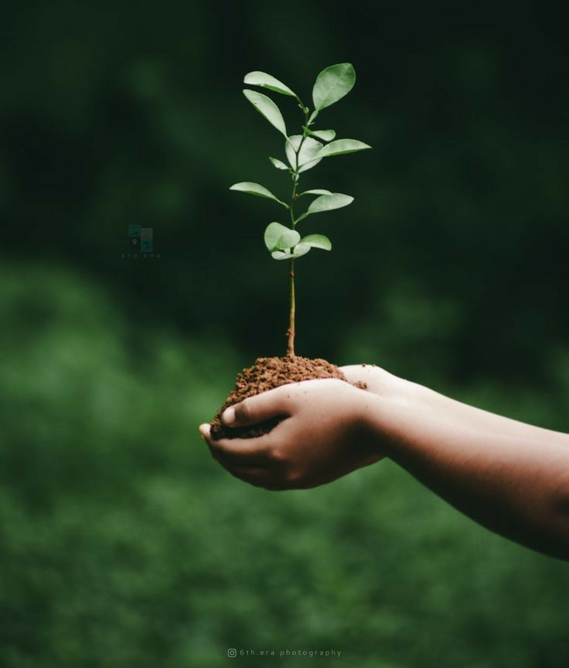
How can individuals contribute to sustainable development?
Individuals can contribute by raising awareness, adapting sustainable daily practices, supporting inclusive policies and participating in community or global initiatives that align with the SDGs.

Slide 27
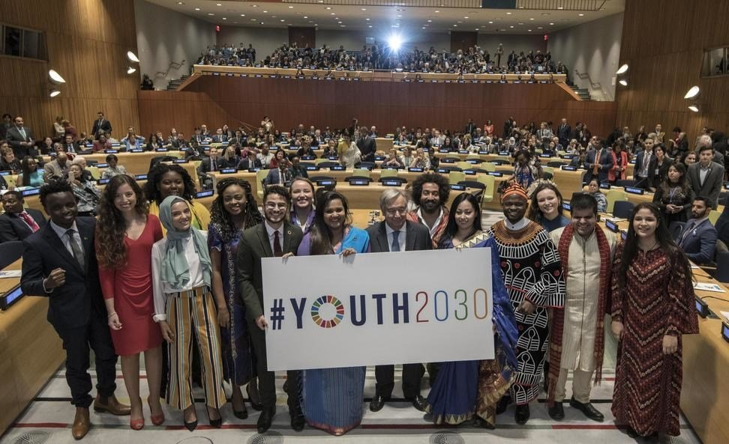

How does the United Nations support education and youth development?
funding
health and wellbeing
youth participation
training & skills
polices & standards

Slide 28






Which UN programmes focus on children and young people?
UNICEF
UNESCO
UNDP
UNFPA
ILO
United Nations youth office

Slide 29
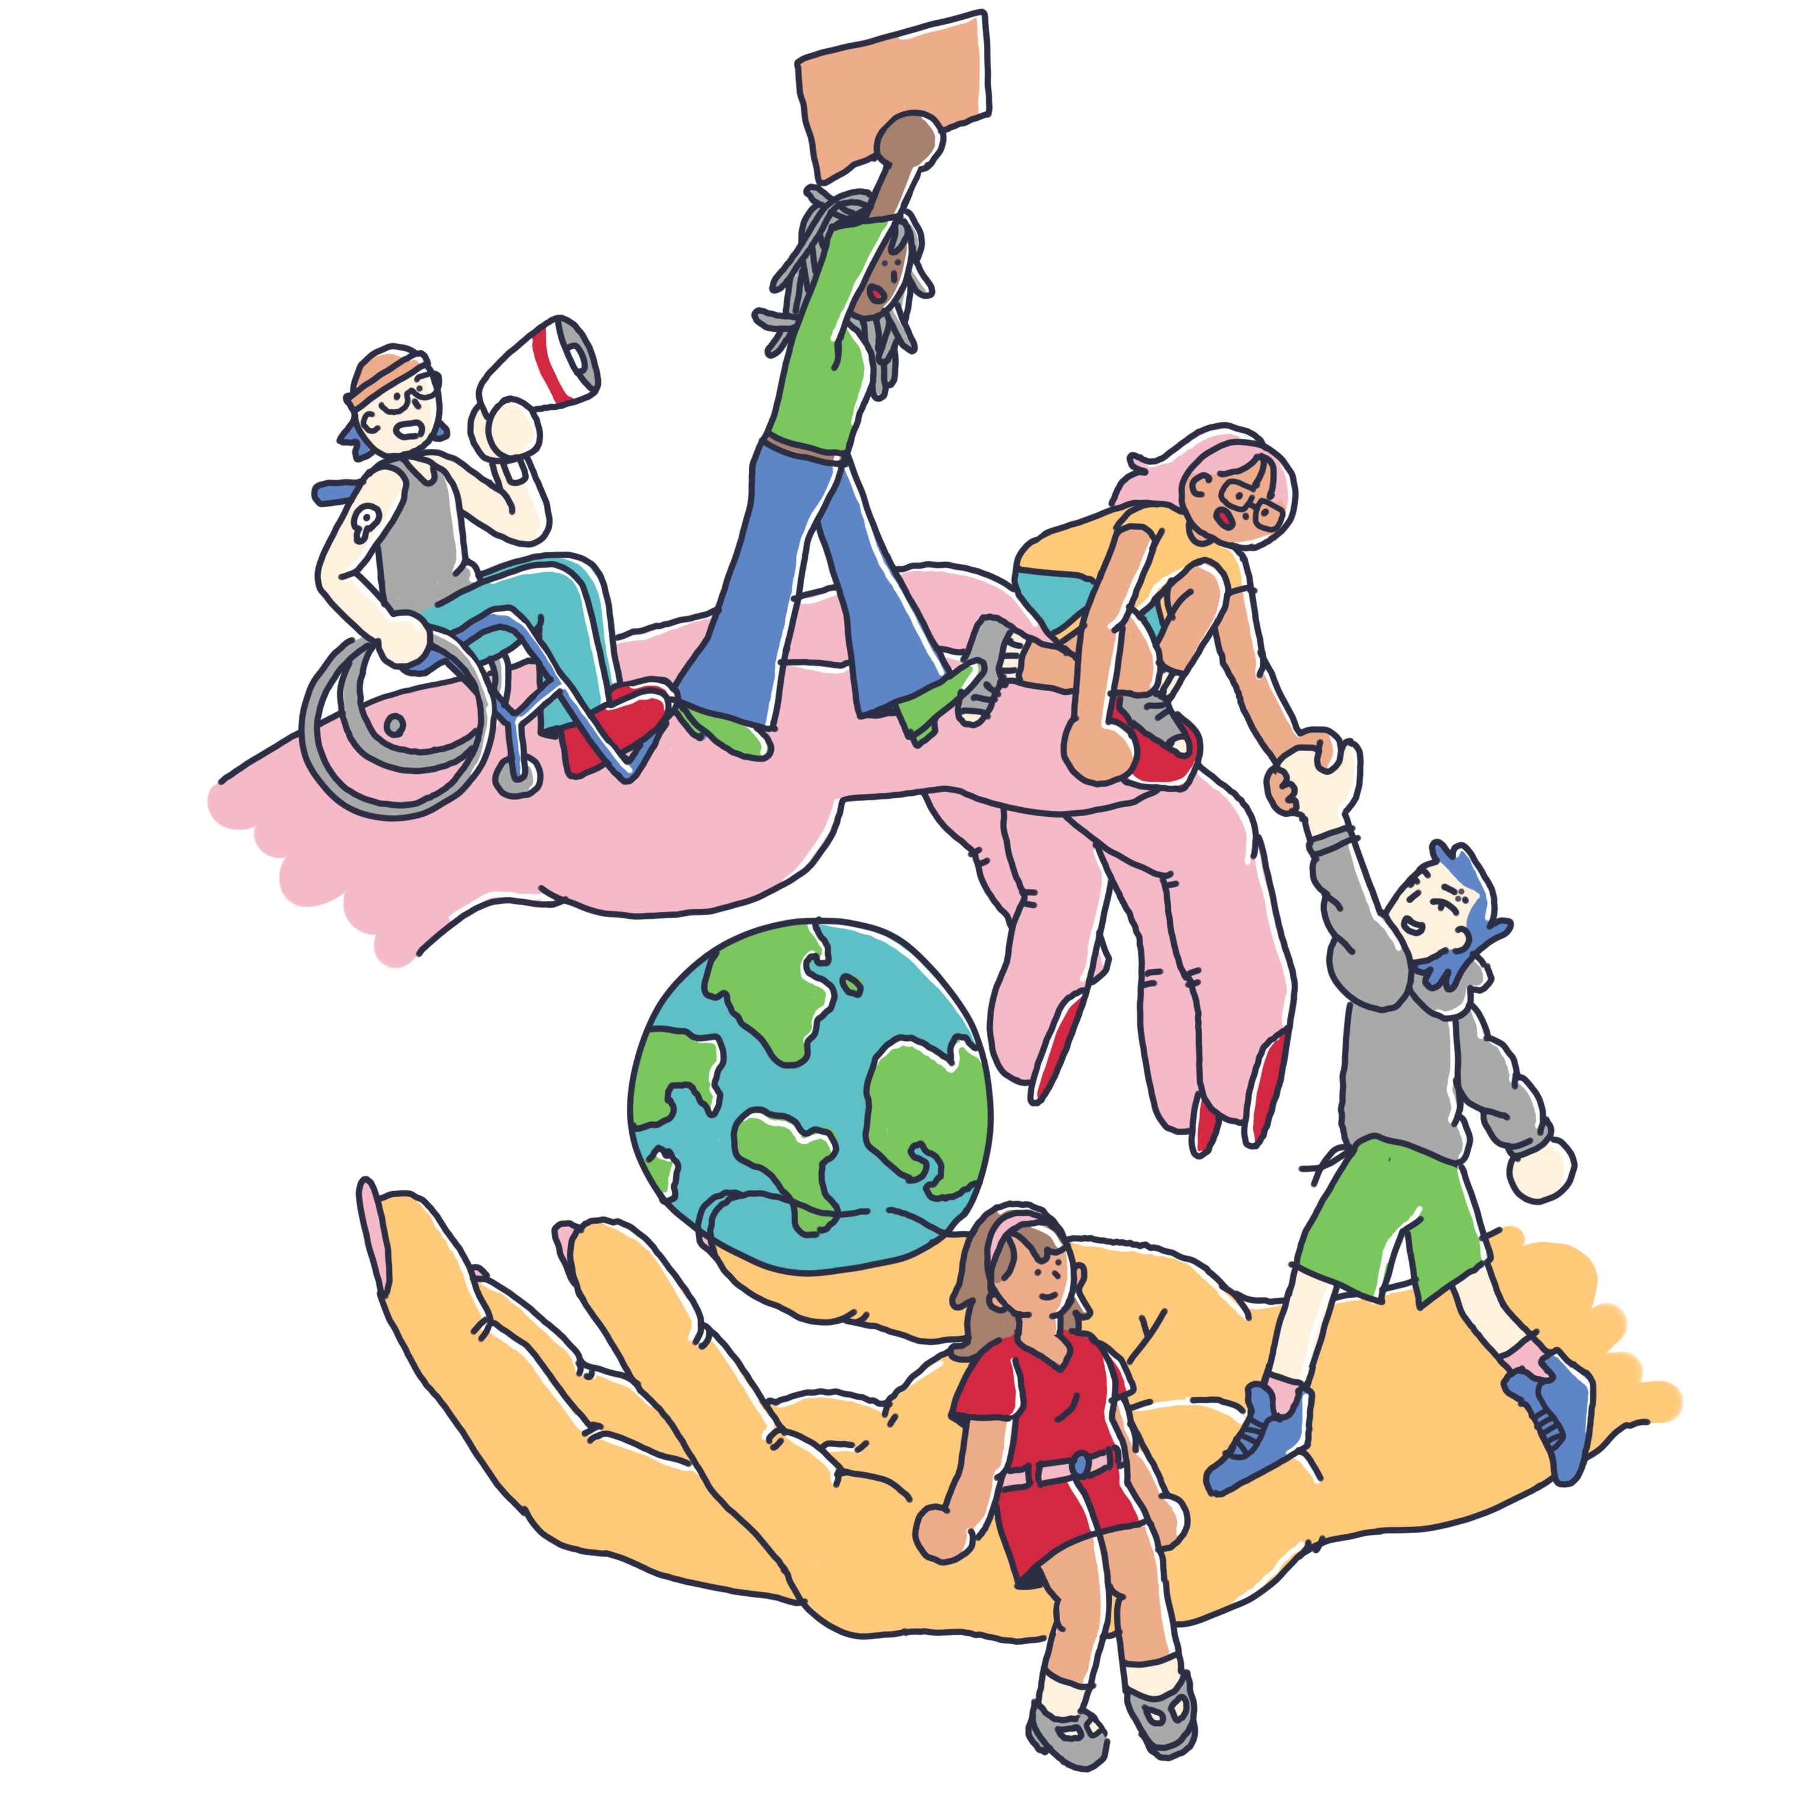
Why is youth participation important for global change?
They represent the future
Fresh innovations and ideas
Social and digital influence
Strengtening democrasy

Slide 30
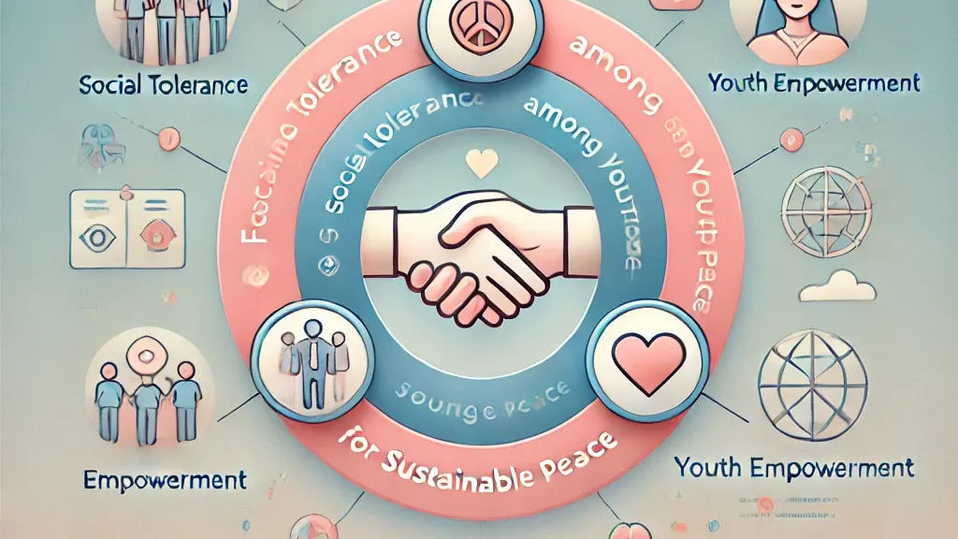
How can young people promote peace and tolerance?
Using social media responsibly
Participating in youth organisations and initiatives
Education and open dialogue

Slide 31
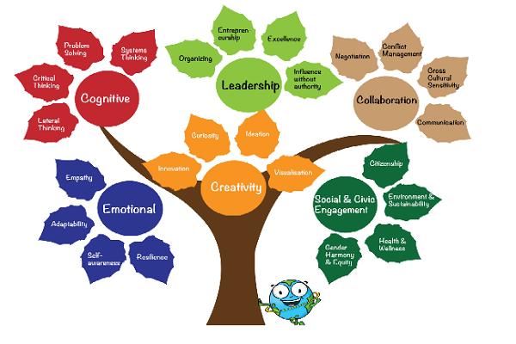
What UN values can students apply in everyday life?
Respect for humans rights- treating everyone with dignity
Tolerance- accepting different options and cultures
Peace and non-violence- resolving conflicts through dialogue
Solidarity- helping others in need
Responsibility- being accountable for one´s actions
Sustainable development- protecting the environment
Cooperation- working together and respecting others

Slide 32
THANK YOU FOR YOUR ATENTION!

